Slide 1
Supplementary Figures

Slide 2
J
F
M
A
M
J
J
A
S
O
N
D
Figure S1: Future changes (2081-2100 vs. 1981-2000) in surface temperature (K) in each month.

Slide 3
J
F
M
A
M
J
J
A
S
O
N
D
Figure S2: Future changes (2081-2100 vs. 1981-2000) in geopotential height (m) in each month.

Slide 4
J
F
M
A
M
J
J
A
S
O
N
D
Figure S3: Future changes (2081-2100 vs. 1981-2000) in 500 hPa zonal wind (m s⁻¹) in each month.

Slide 5
Figure S4: Future changes (2081-2100 vs. 1981-2000) in sinuosity in red and zonal wind speed (m s⁻¹) in blue in each month.

Slide 6
70N
60N
50N
40N
30N
Figure S5: Annual cycle of sinuosity by latitude in LENS during the late 20th century (1948-2014). Individual ensemble members are shown in light shading, and ensemble means are represented by bold lines.

Slide 7
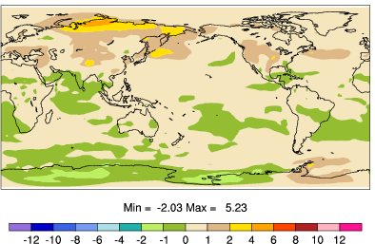
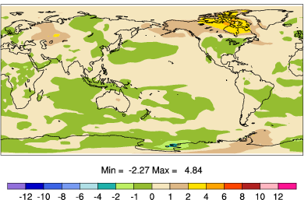
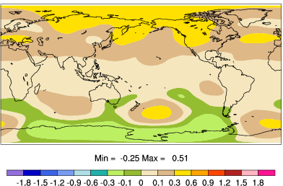
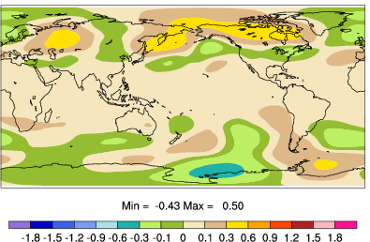
(a)
Surface Temperature (K)
(b)
Surface Temperature (K)
(c)
500 hPa Heights (m)
(d)
500 hPa Heights (m)
Figure S6: As in Figure 12 but for supplemental simulations in which snow cover was suppressed only over (a, c) Eurasia and (b, d) North America.

Slide 8
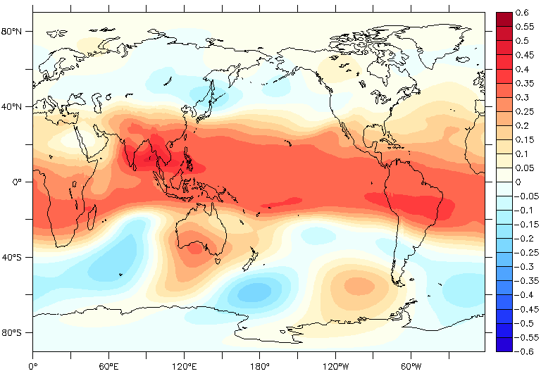
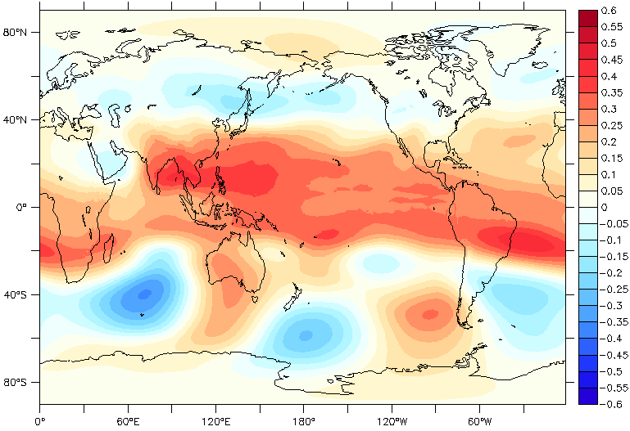
Late 20th Century (1981-2000)
Late 21st Century (2081-2100)
Figure S7: Correlation during August between 500 hPa geopotential heights and rainfall over the Indian Ocean region experiencing the largest future rainfall increase (9ºN-11ºN, 61ºE-65ºE) during the (top) late 20th century and (bottom) late 21st century averaged among all 40 ensemble members .

